Slide 1
TypeScript Basic
Bootcamp [TypeScript]
Dmitry Kiselyov

Slide 2

What is TypeScript?
TypeScript is an open-source language which builds on JavaScript, one of the world’s most used tools, by adding static type definitions.
TypeScript validates that your code is working correctly.
All valid JavaScript code is also TypeScript code (TS errors could be ignored).
TypeScript code is transformed into JavaScript code via the TypeScript compiler or Babel.
Benefits:
Safety & confidence
Reliable refactoring
Time & convenience & comfort
Bootcamp [TypeScript]

Slide 3
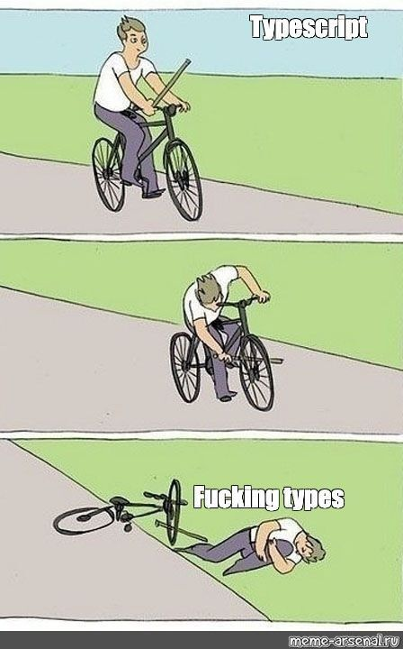
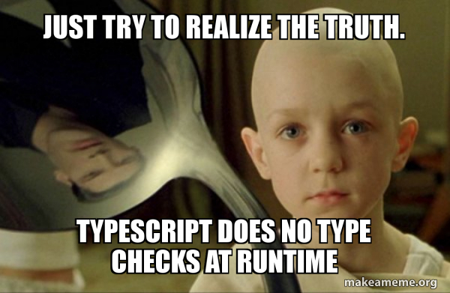

What is TypeScript?
Bootcamp [TypeScript]

Slide 4
Types
JS | TS
null | null
undefined | undefined
boolean | boolean / Boolean
string | string / String
symbol | symbol / Symbol
number | number / Number
bigint | bigint
object | object / Object
function | Function
 | any
 | unknown
 | Array / [] / Tuple
 | void
 | never
 | enum
Don’t ever use the types Number, String, Boolean, Symbol, or Object These types refer to non-primitive boxed objects that are almost never used appropriately in JavaScript code.
The type names Number, String, Boolean, Symbol and Object (starting with capital letters) are legal, but refer to some special built-in types that will very rarely appear in your code.
Always use number, string, boolean, symbol and object for types.
object VS Object
Bootcamp [TypeScript]

Slide 5
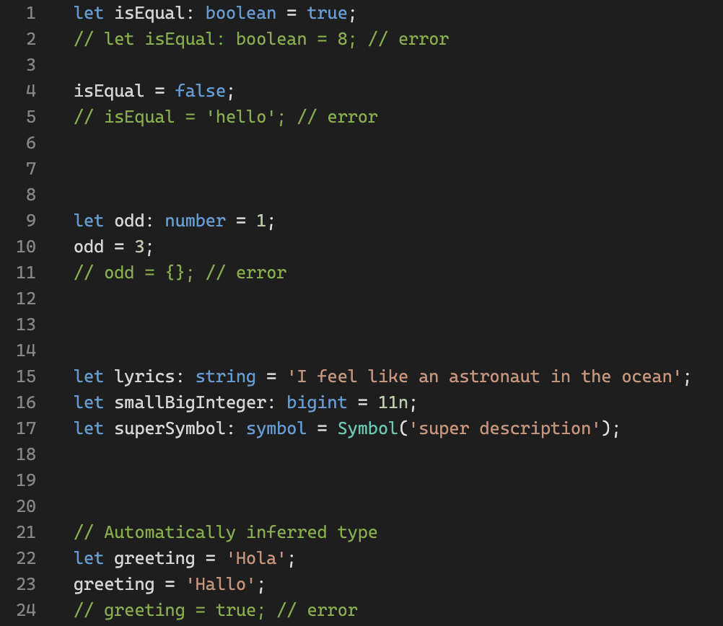
Types: boolean, string, symbol, number, bigint
Playground link
Bootcamp [TypeScript]

Slide 6
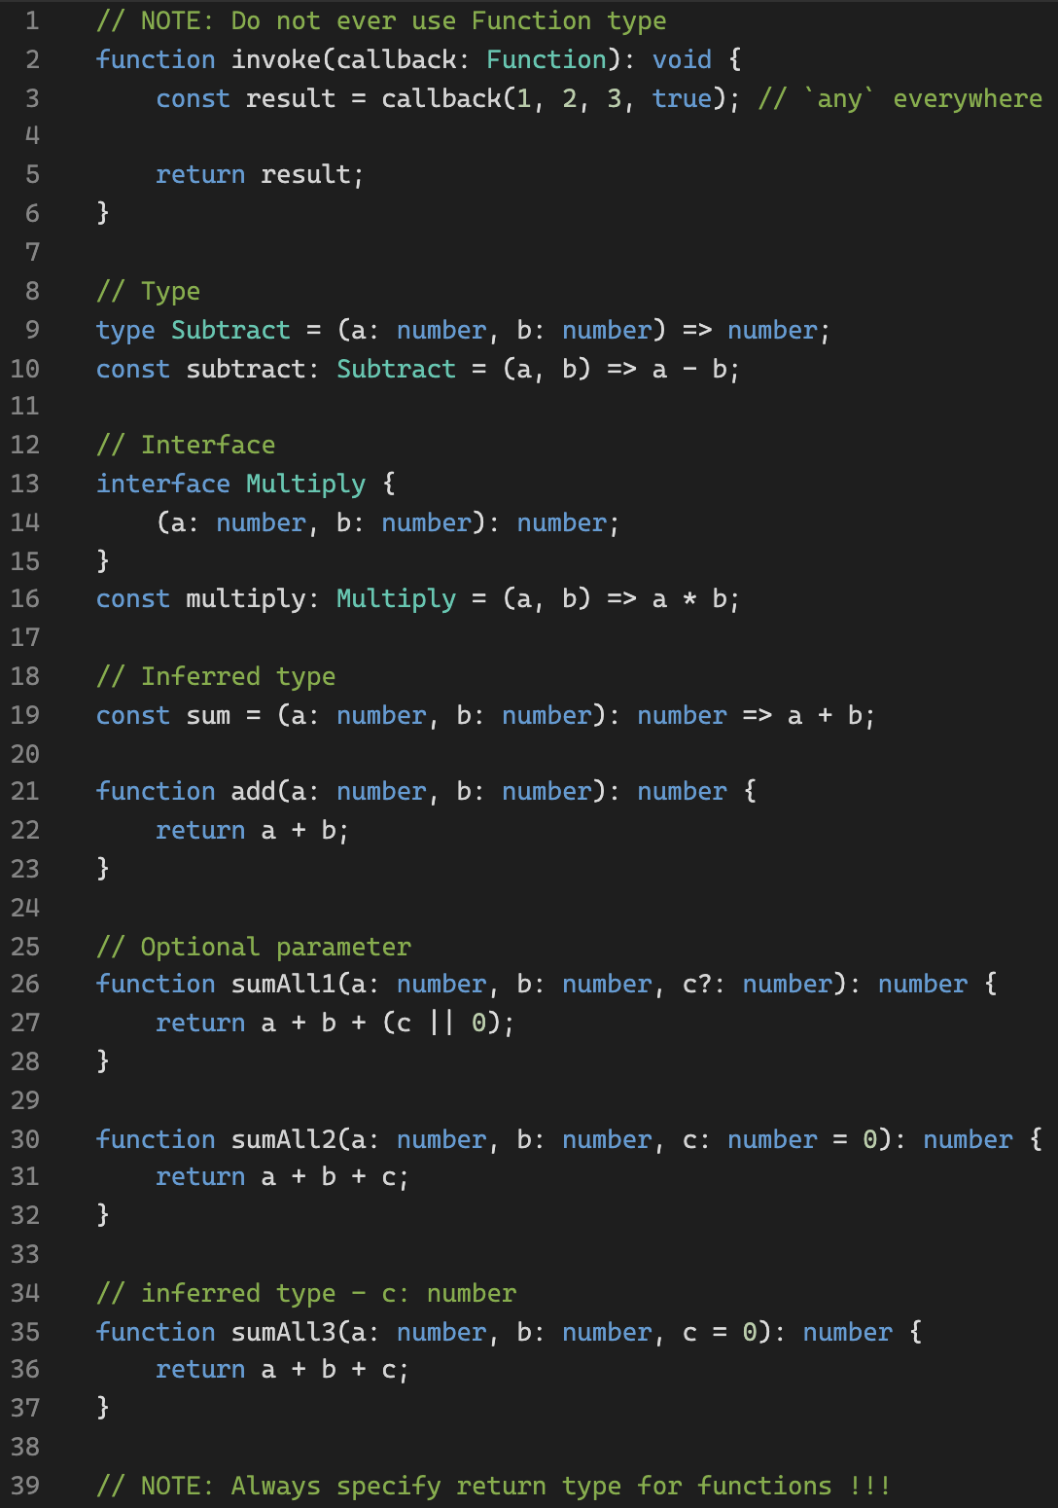
Types: Function
Playground link
Bootcamp [TypeScript]

Slide 7
Types: Function warm-up
Playground link
Bootcamp [TypeScript]

Slide 8
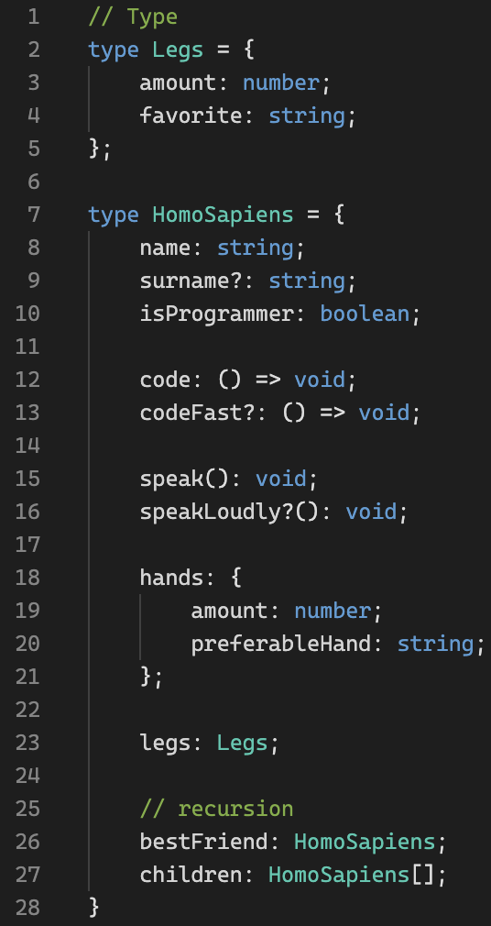
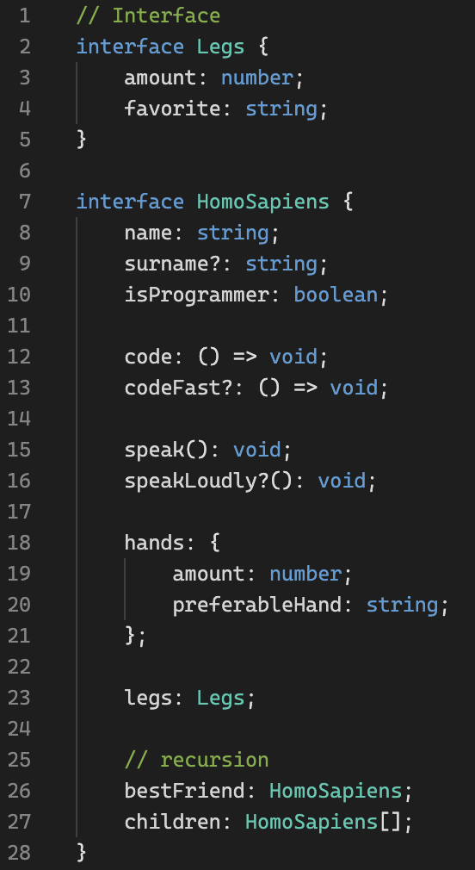
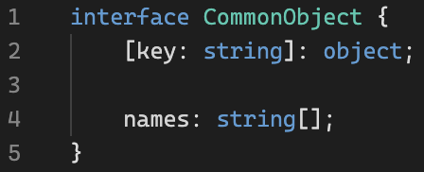
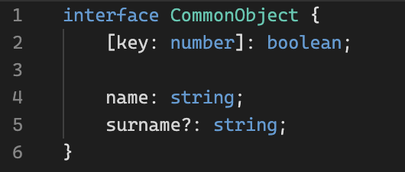
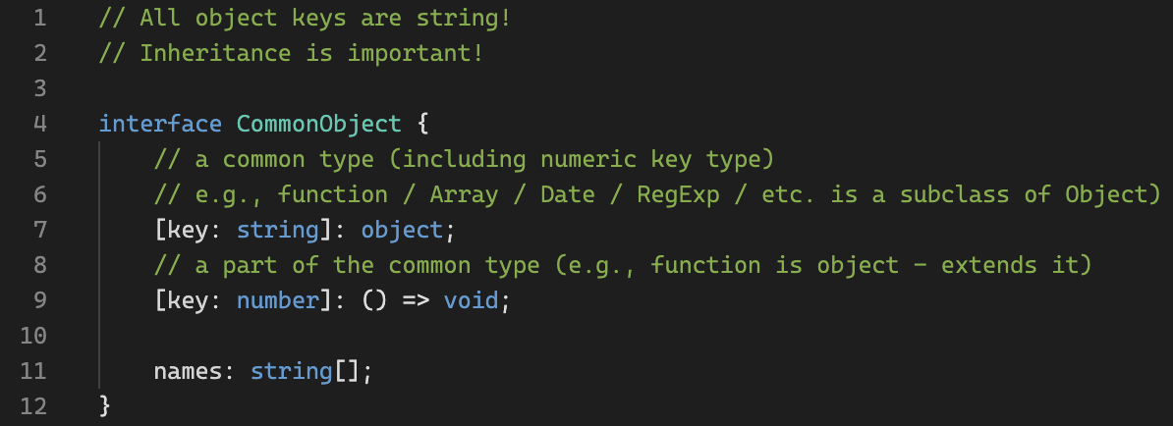
Types: object
Playground link
Bootcamp [TypeScript]

Slide 9
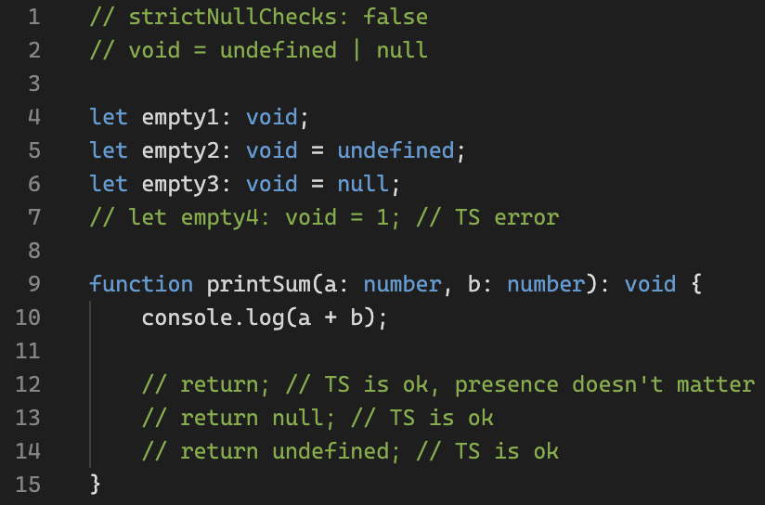
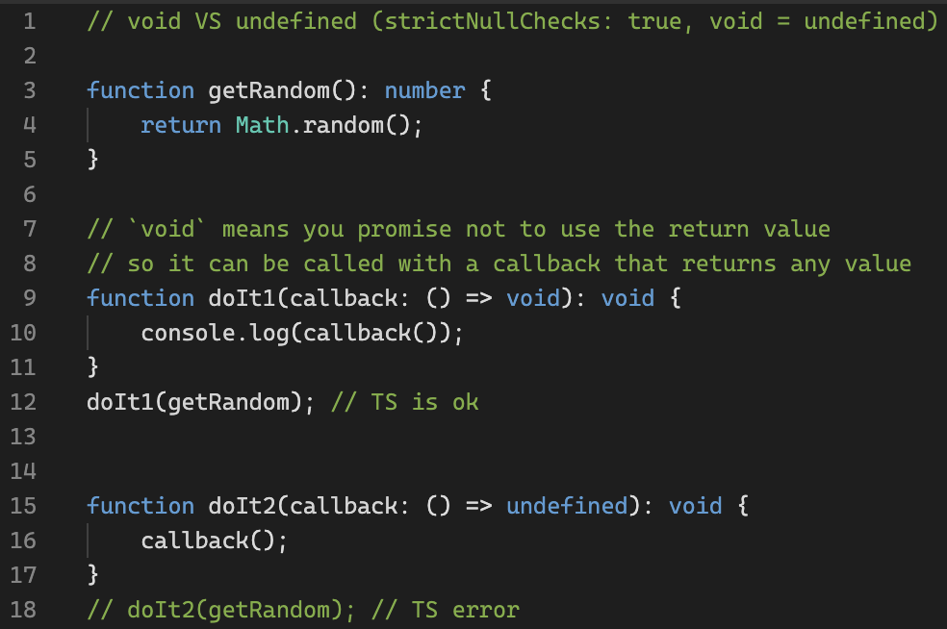
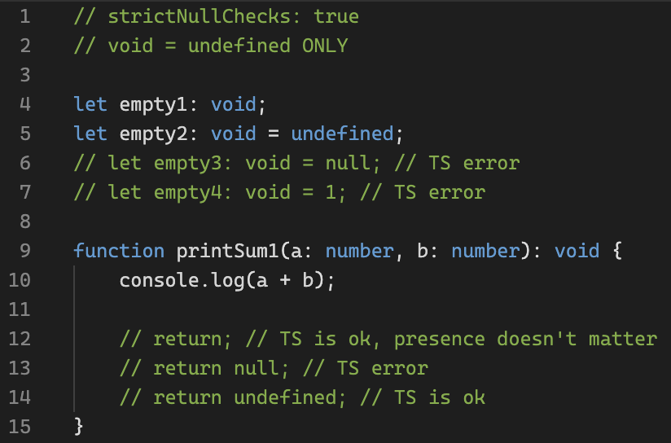
Types: null, undefined, void
Playground link (strictNullChecks: false)
Playground link (strictNullChecks: true)
Playground link (void VS undefined)
Bootcamp [TypeScript]

Slide 10
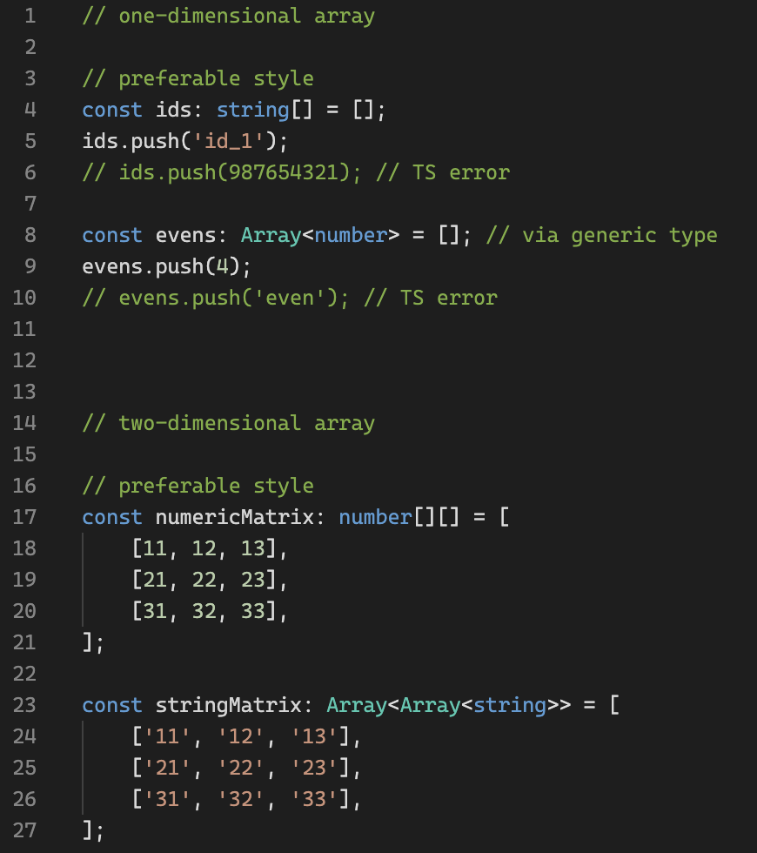
Types: Array / []
Playground link
Bootcamp [TypeScript]

Slide 11
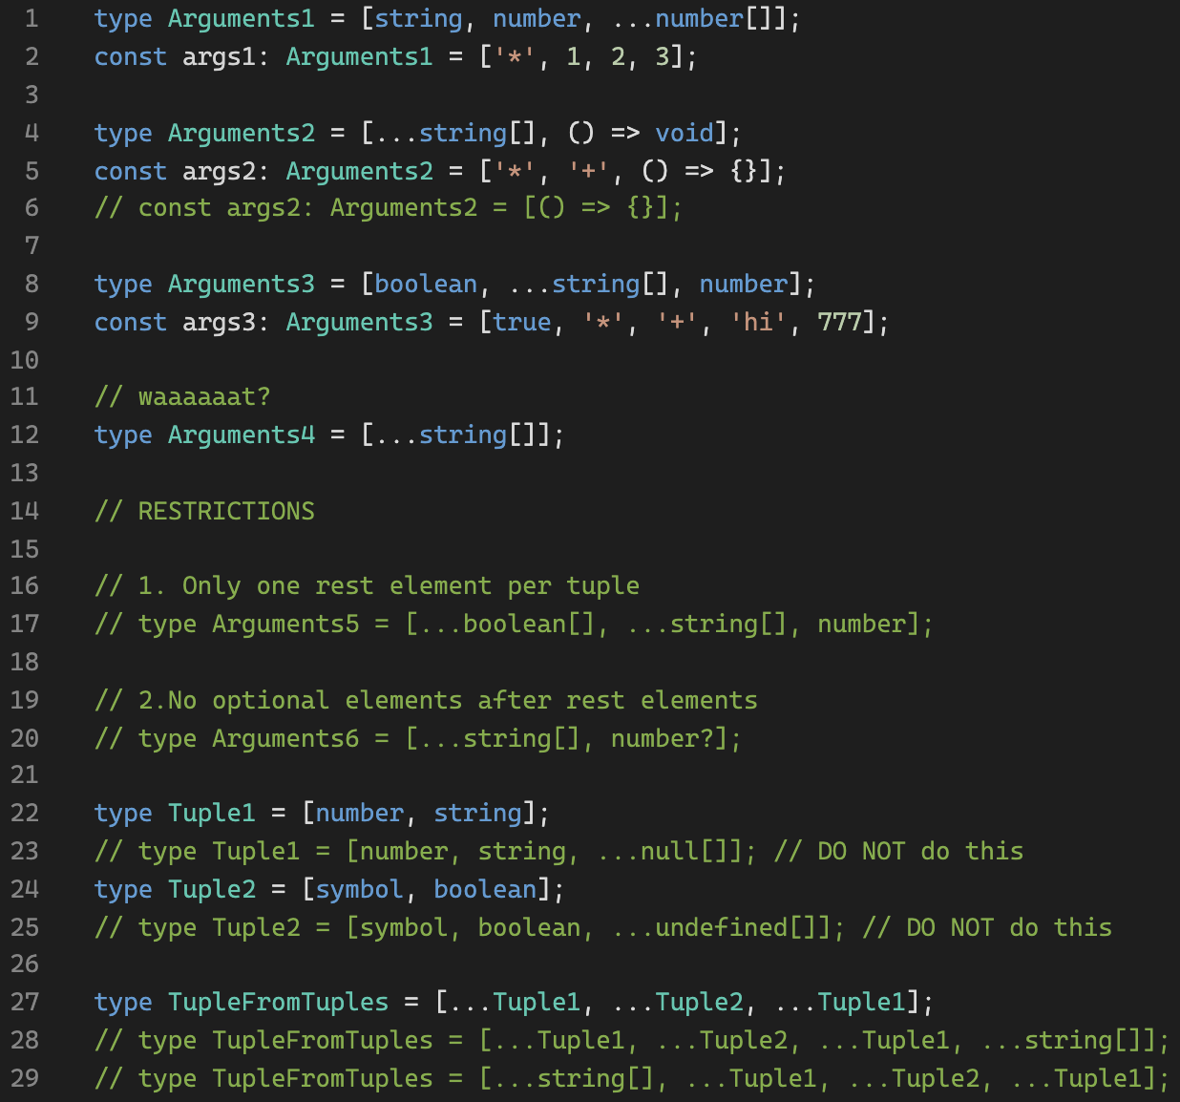
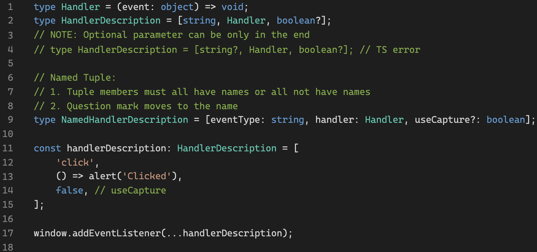
Types: Tuple
Playground link
Bootcamp [TypeScript]

Slide 12
Types: warm-up
Playground link
Bootcamp [TypeScript]

Slide 13
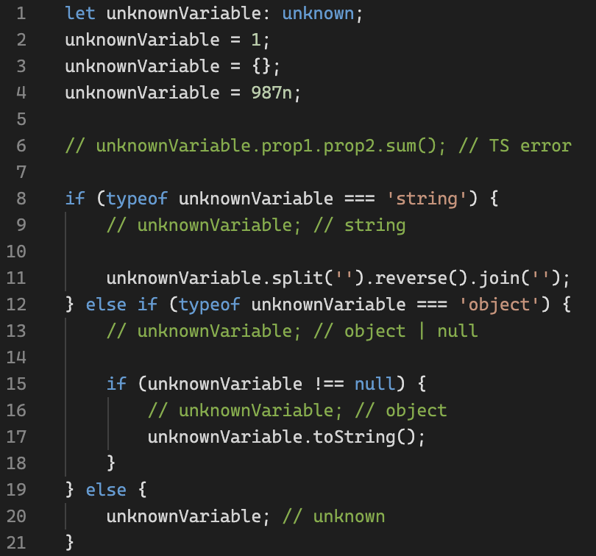
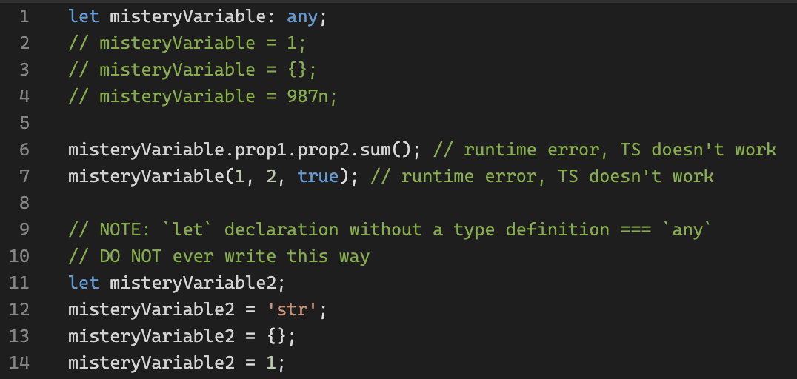
Types: any, unknown
Playground link
Bootcamp [TypeScript]

Slide 14
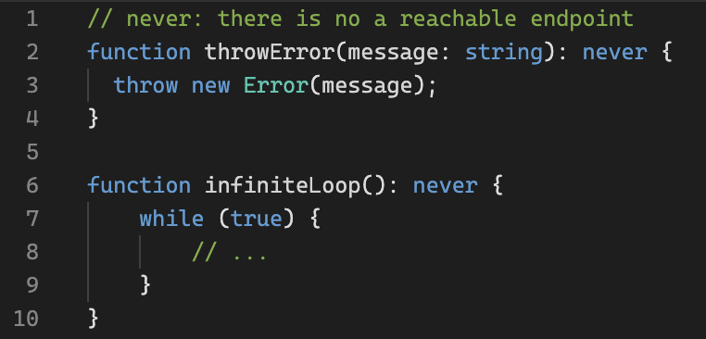
Types: never
Playground link
Bootcamp [TypeScript]

Slide 15
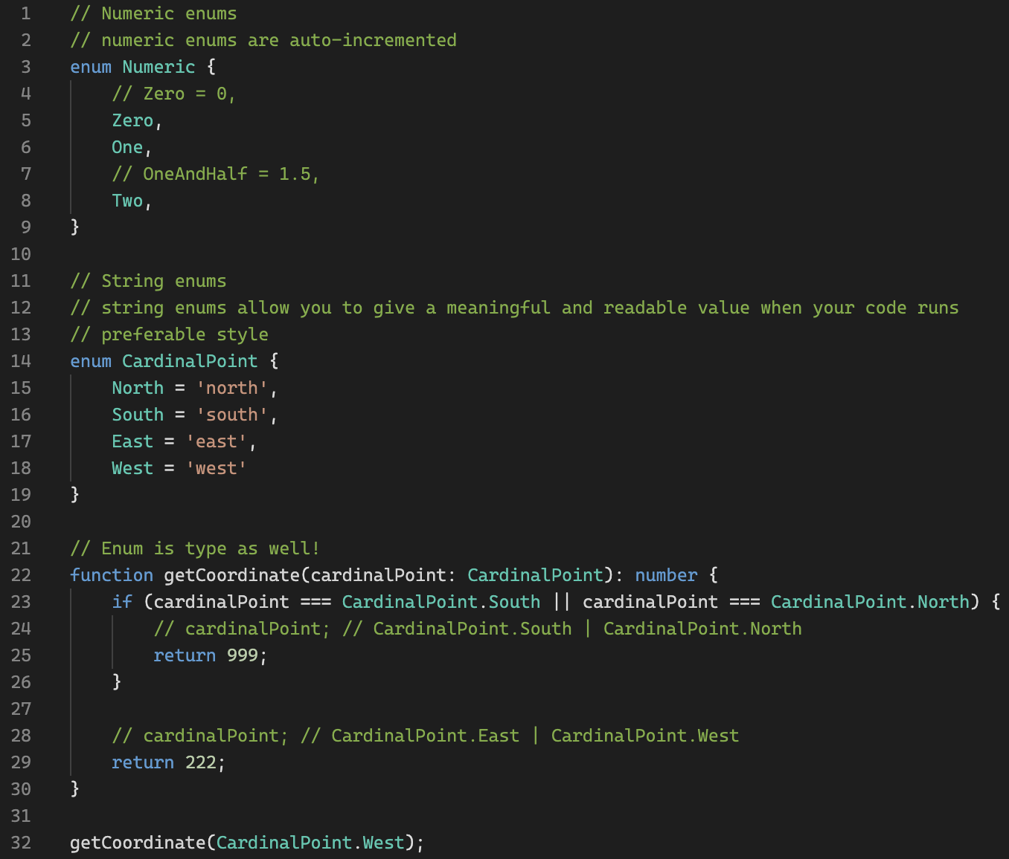
Types: enum
Playground link
Bootcamp [TypeScript]

Slide 16
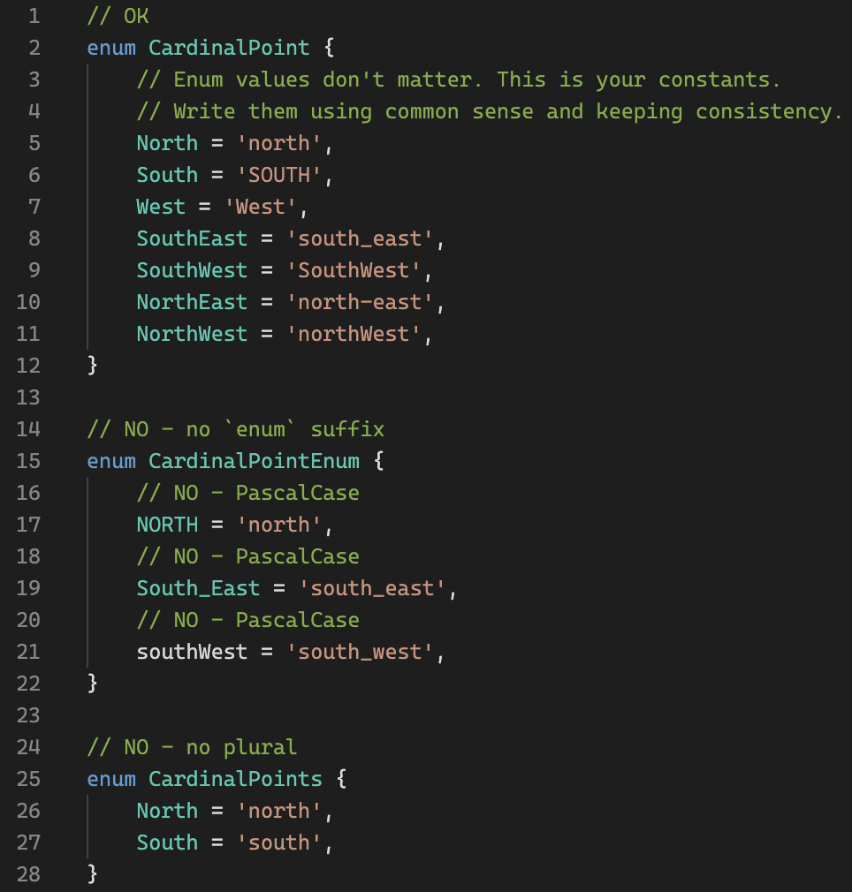
Types: enum naming convention
Playground link
DOS:
✅ Use PascalCase for Enum types and value names.
✅ Use a singular name for Enum types.
DON’TS:
❌ Do not use an Enum suffix on Enum type names.
Bootcamp [TypeScript]

Slide 17
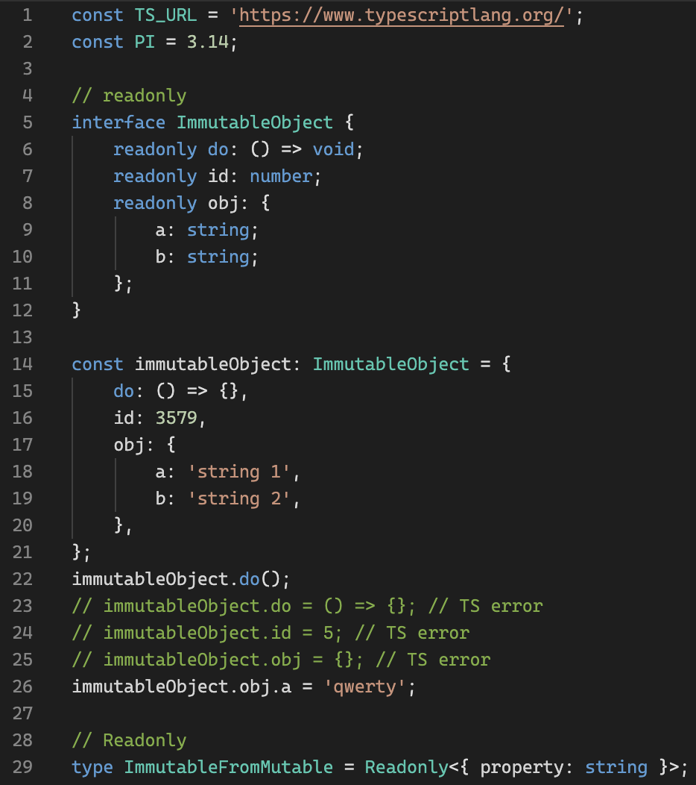
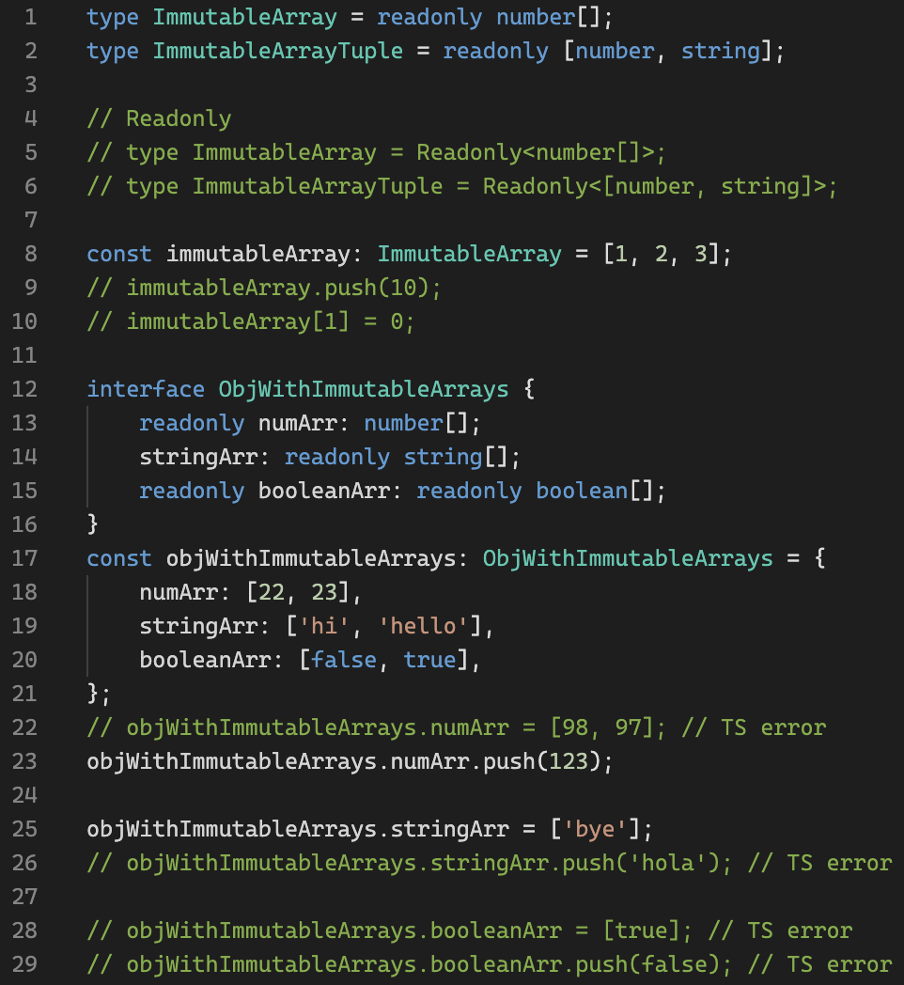
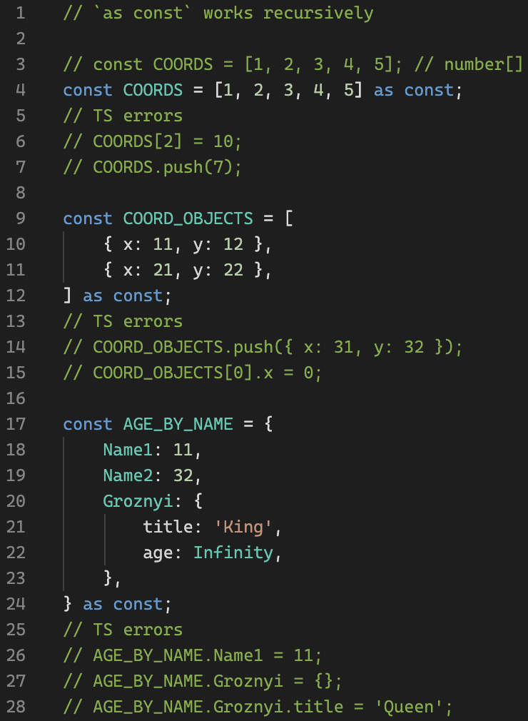
Types: Literal Types / as const
Playground link
Bootcamp [TypeScript]

Slide 18
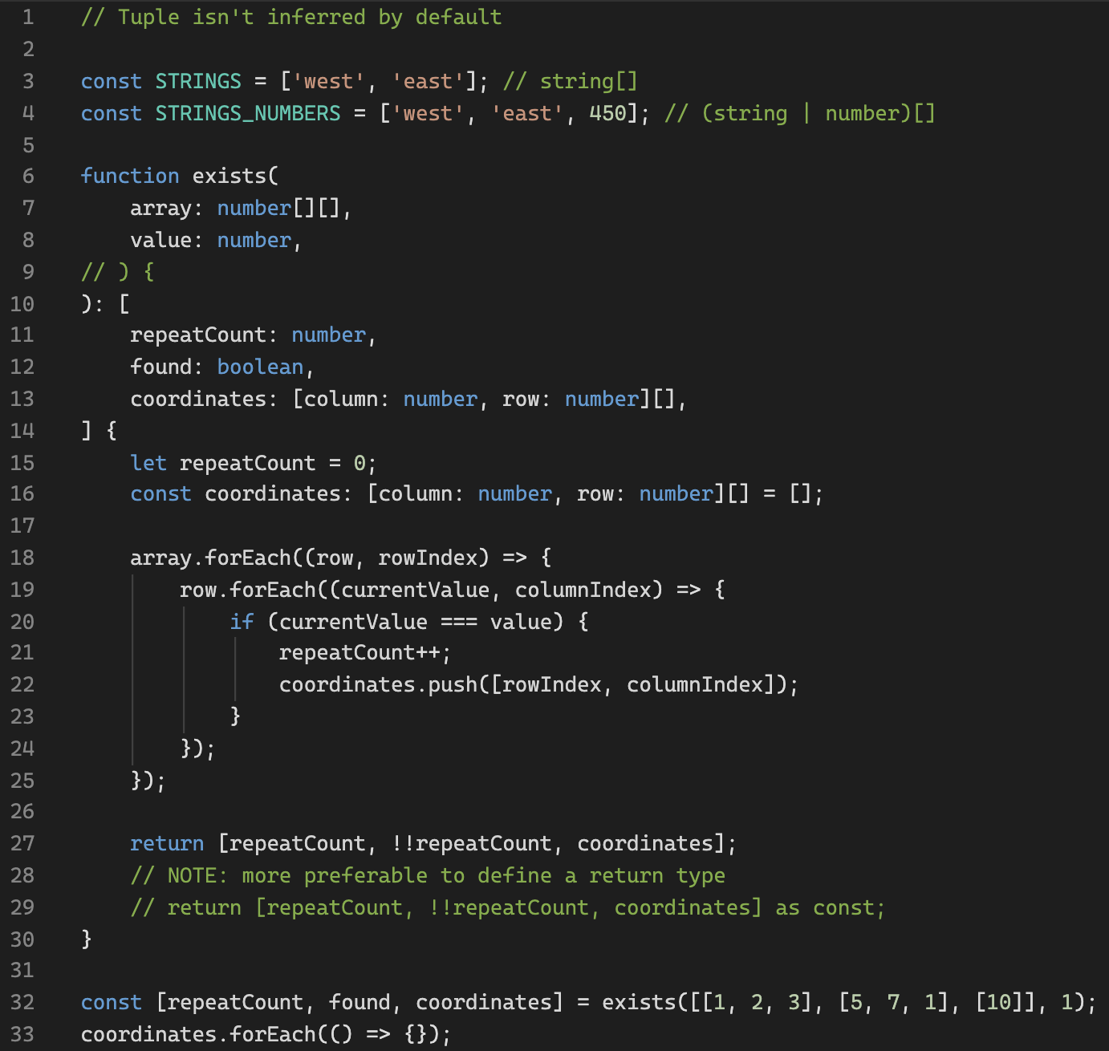
Types: inferred array type
Playground link
Bootcamp [TypeScript]

Slide 19
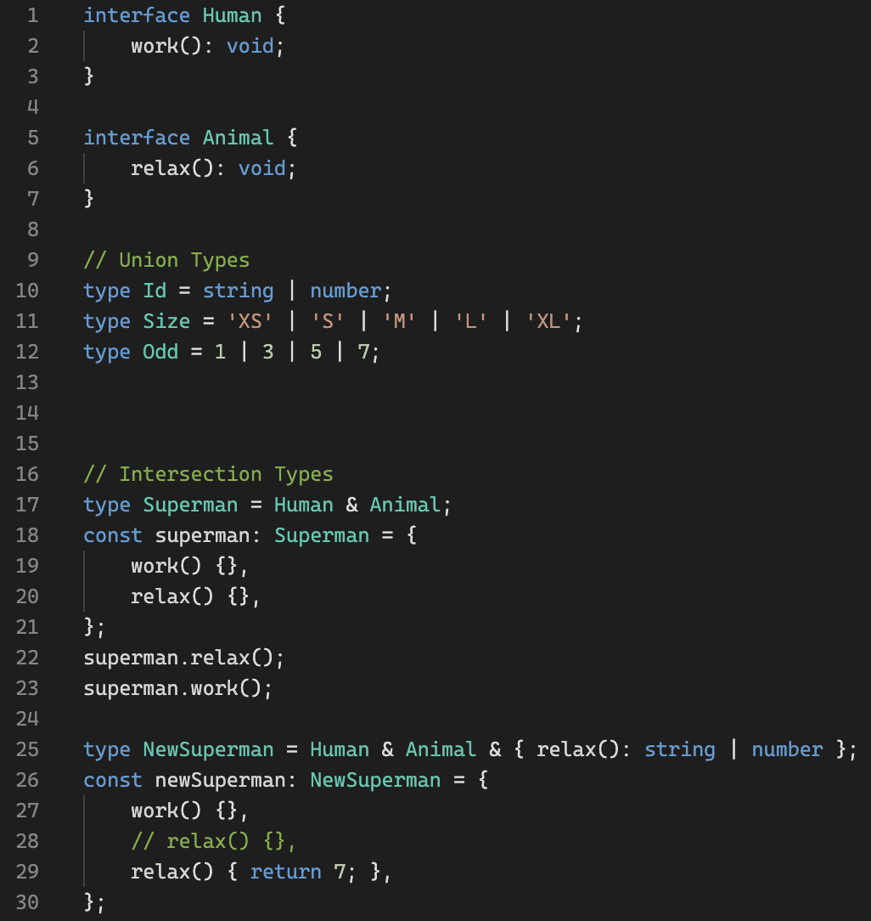
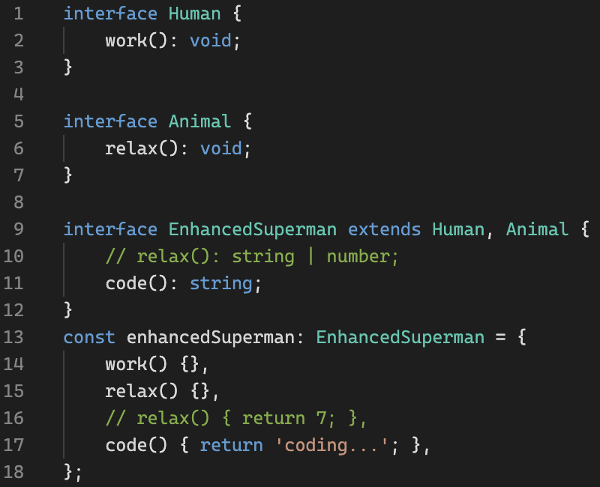
Types: Unions and Intersection Types
Playground link
Bootcamp [TypeScript]

Slide 20
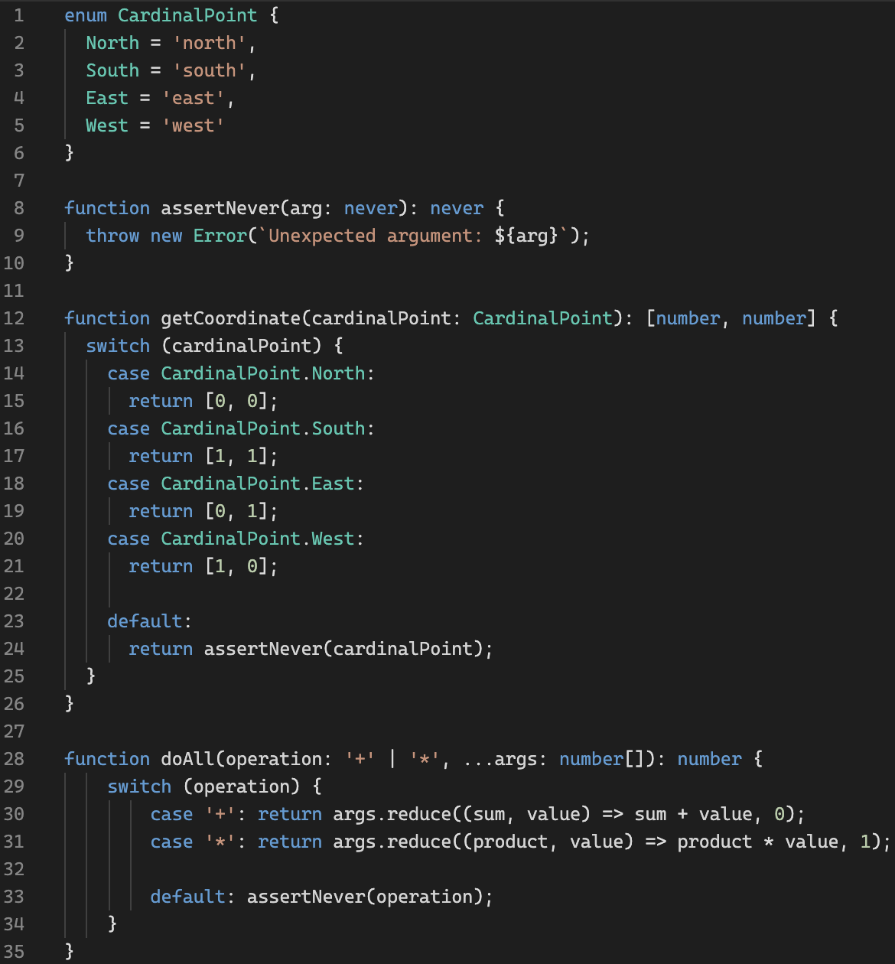
Types: exhaustive check
Playground link
Bootcamp [TypeScript]

Slide 21
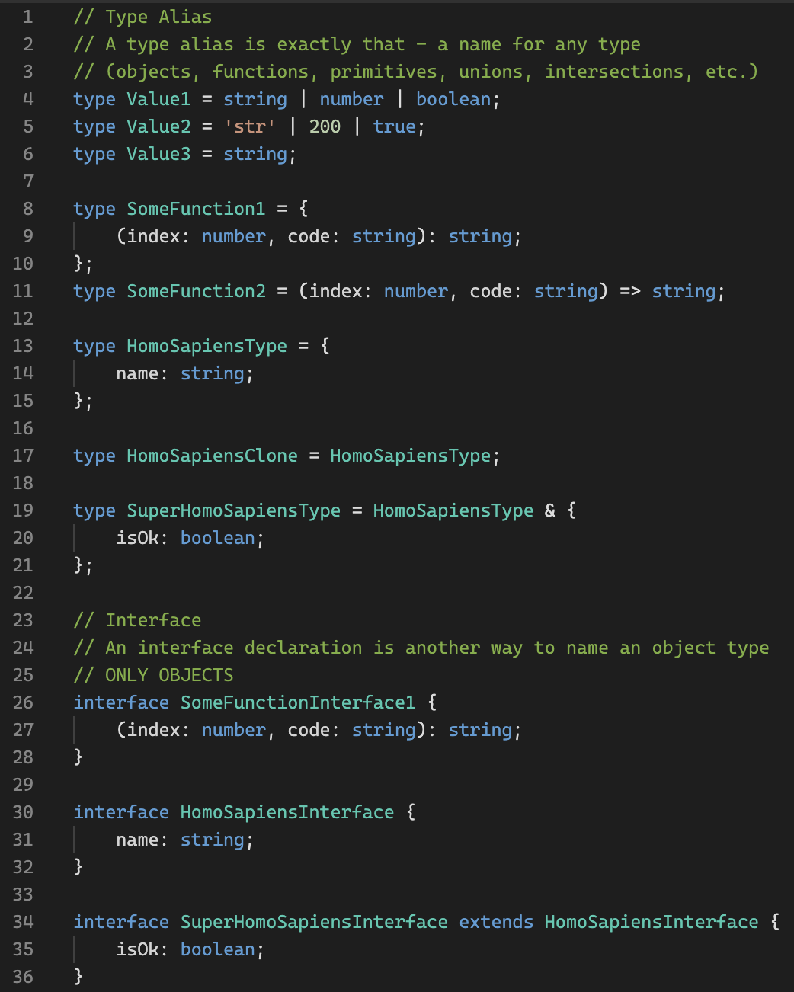
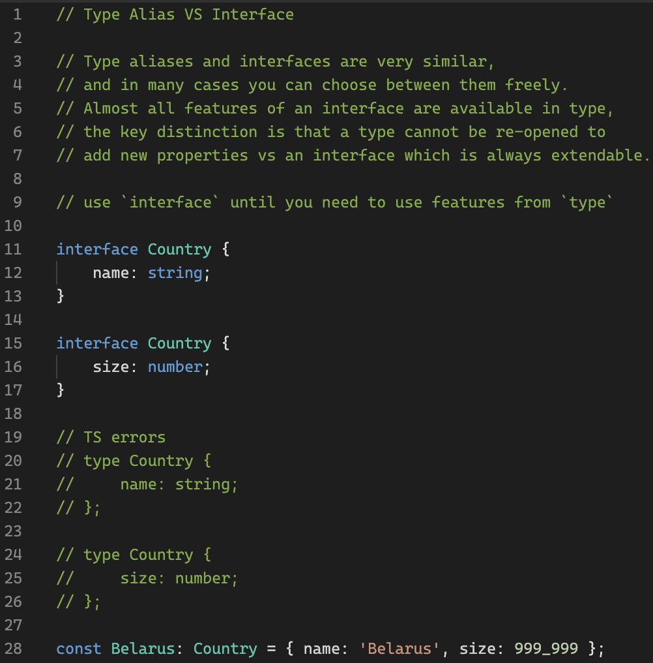
Types: Type VS Interface
Playground link
Bootcamp [TypeScript]

Slide 22
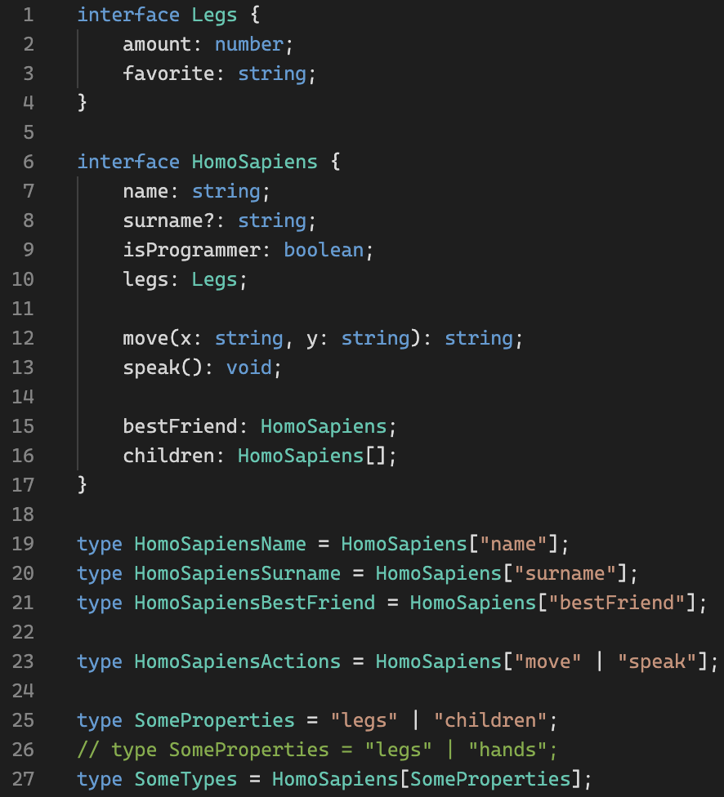
Types: indexed access
Playground link
Bootcamp [TypeScript]

Slide 23
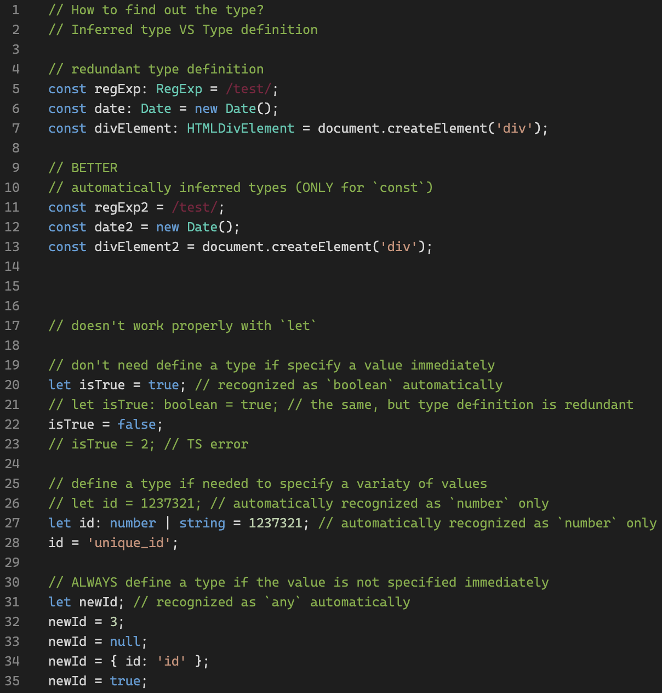
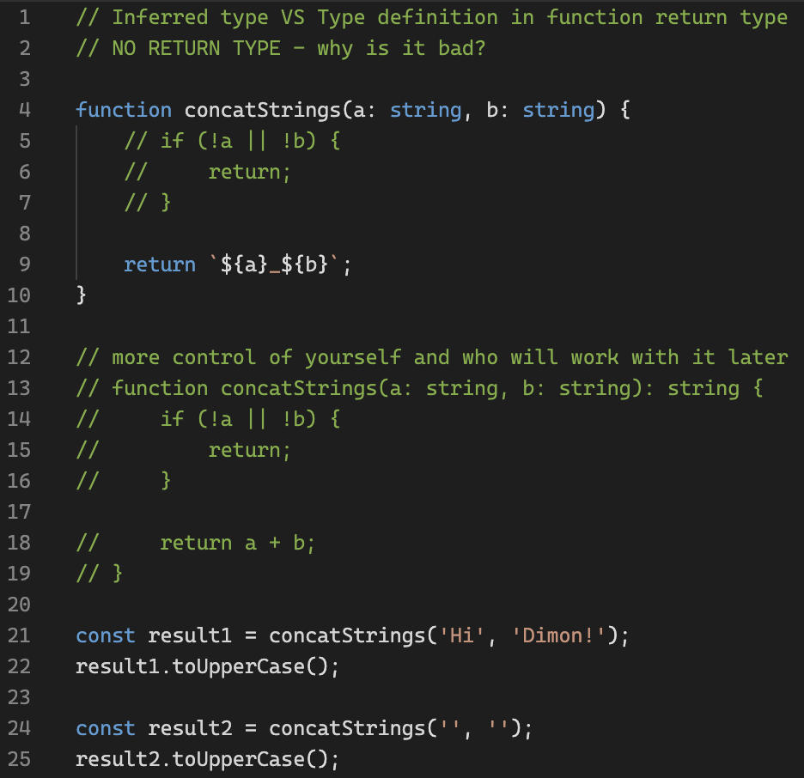
Types: tips
Playground link
Bootcamp [TypeScript]

Slide 24
Types: warm-up
Playground link
Bootcamp [TypeScript]

Slide 25
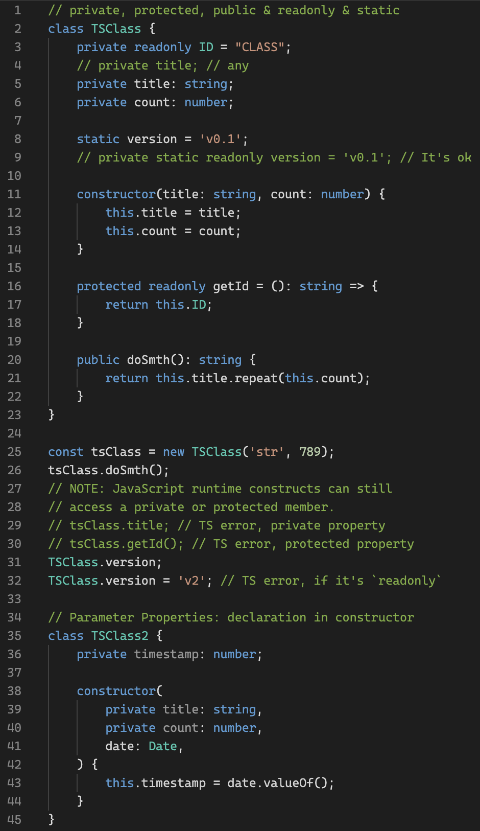
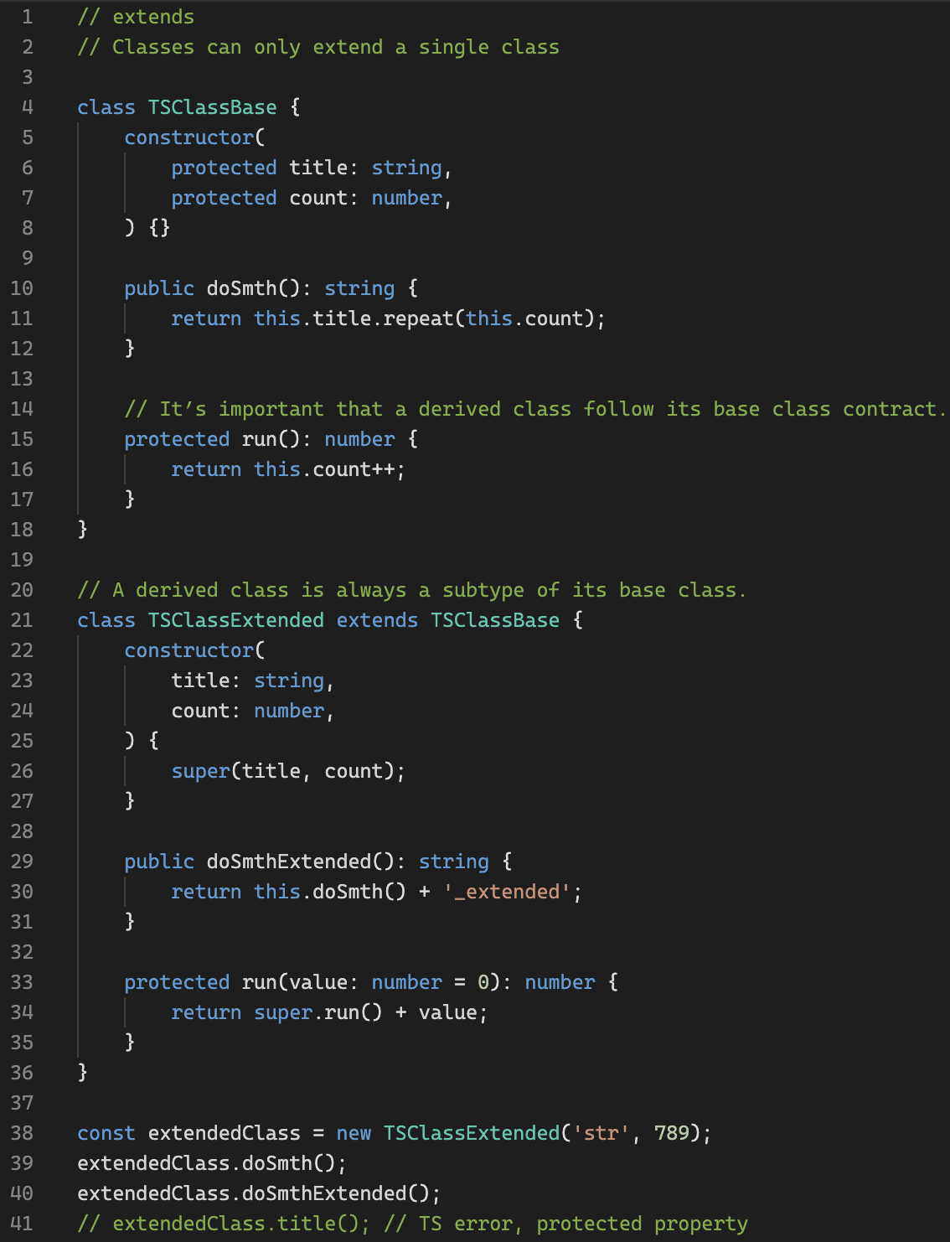
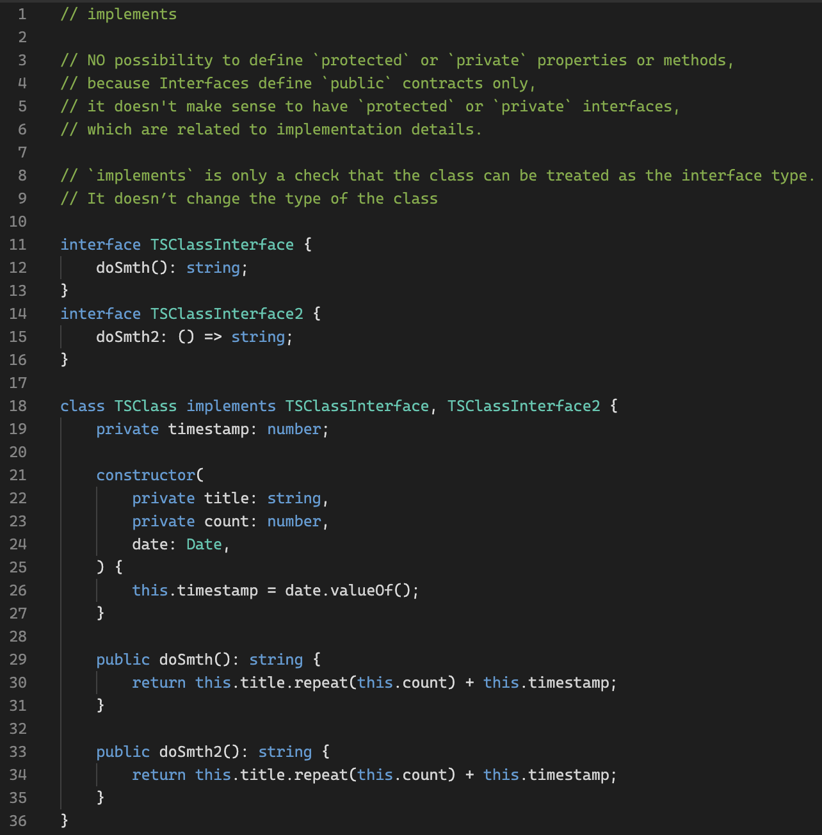
Classes
Playground link 1
Playground link 2
Bootcamp [TypeScript]

Slide 26
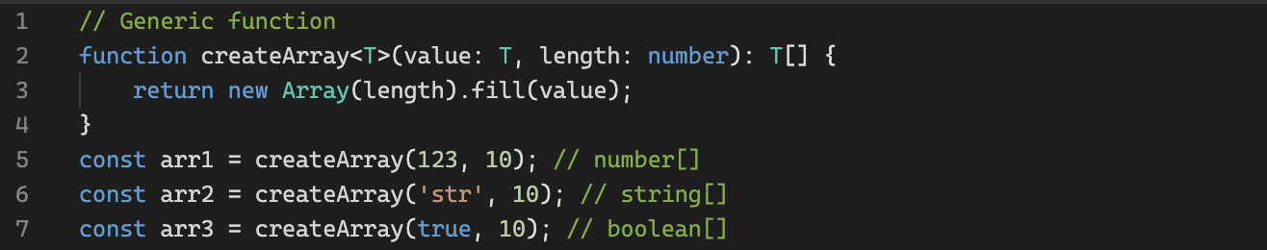
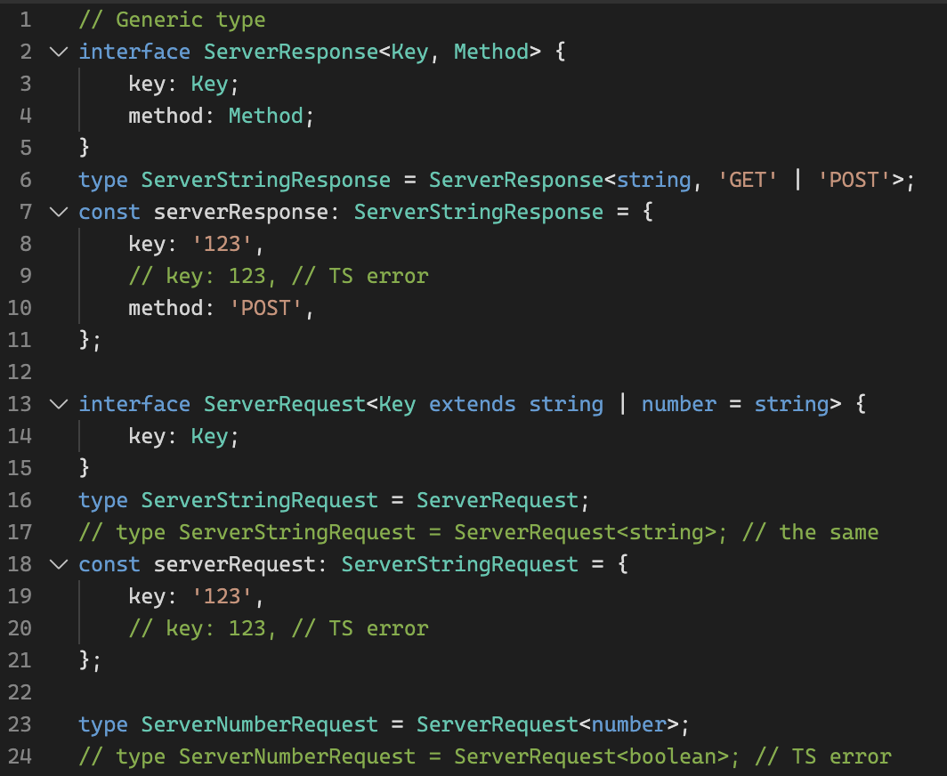
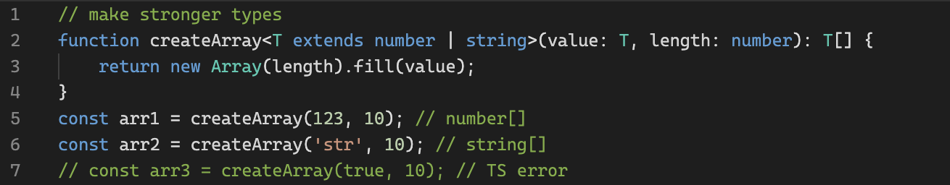
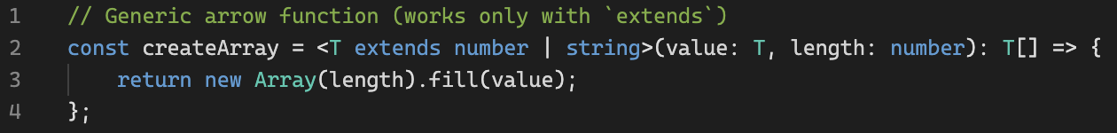
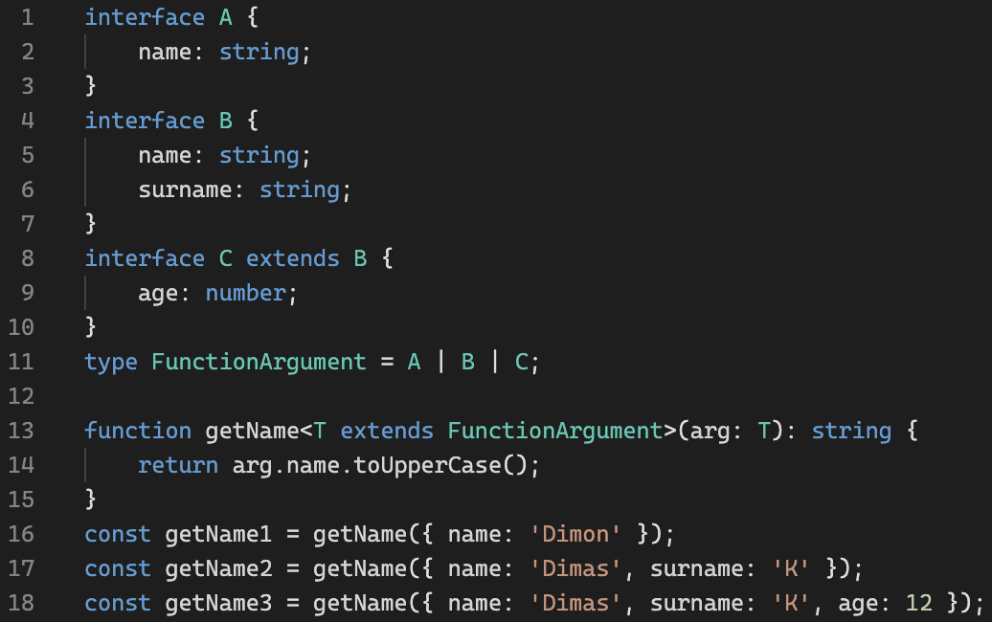
Generic
Playground link
Bootcamp [TypeScript]

Slide 27
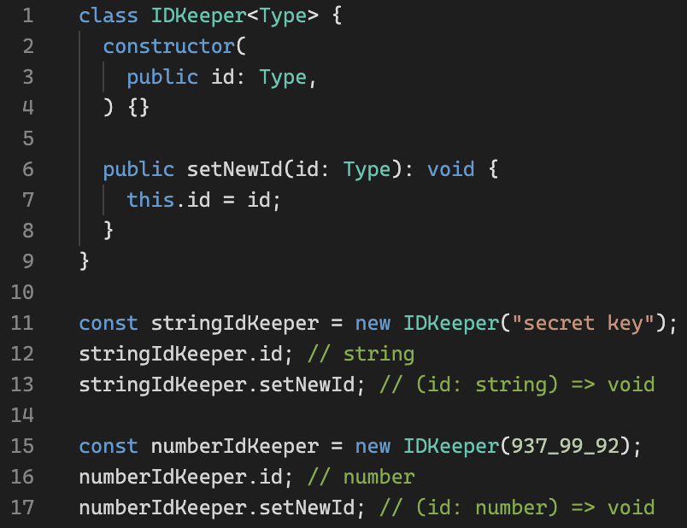
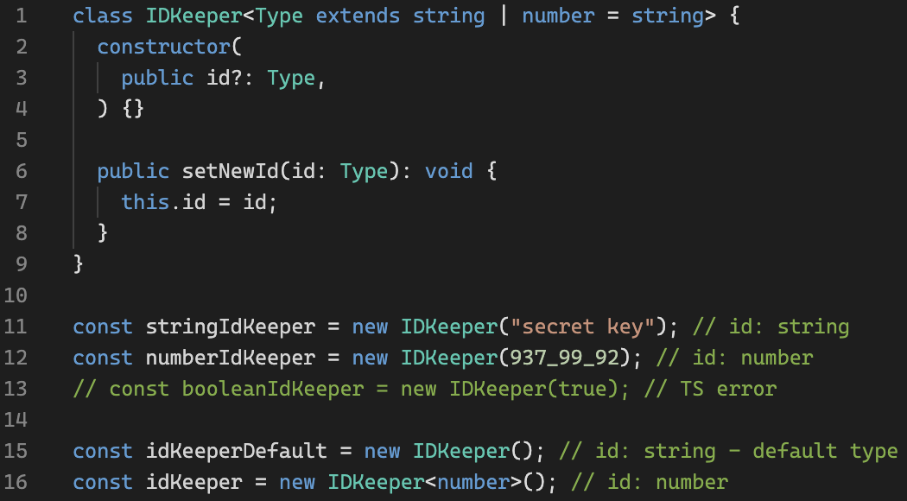
Generic Classes
Playground link
Bootcamp [TypeScript]

Slide 28
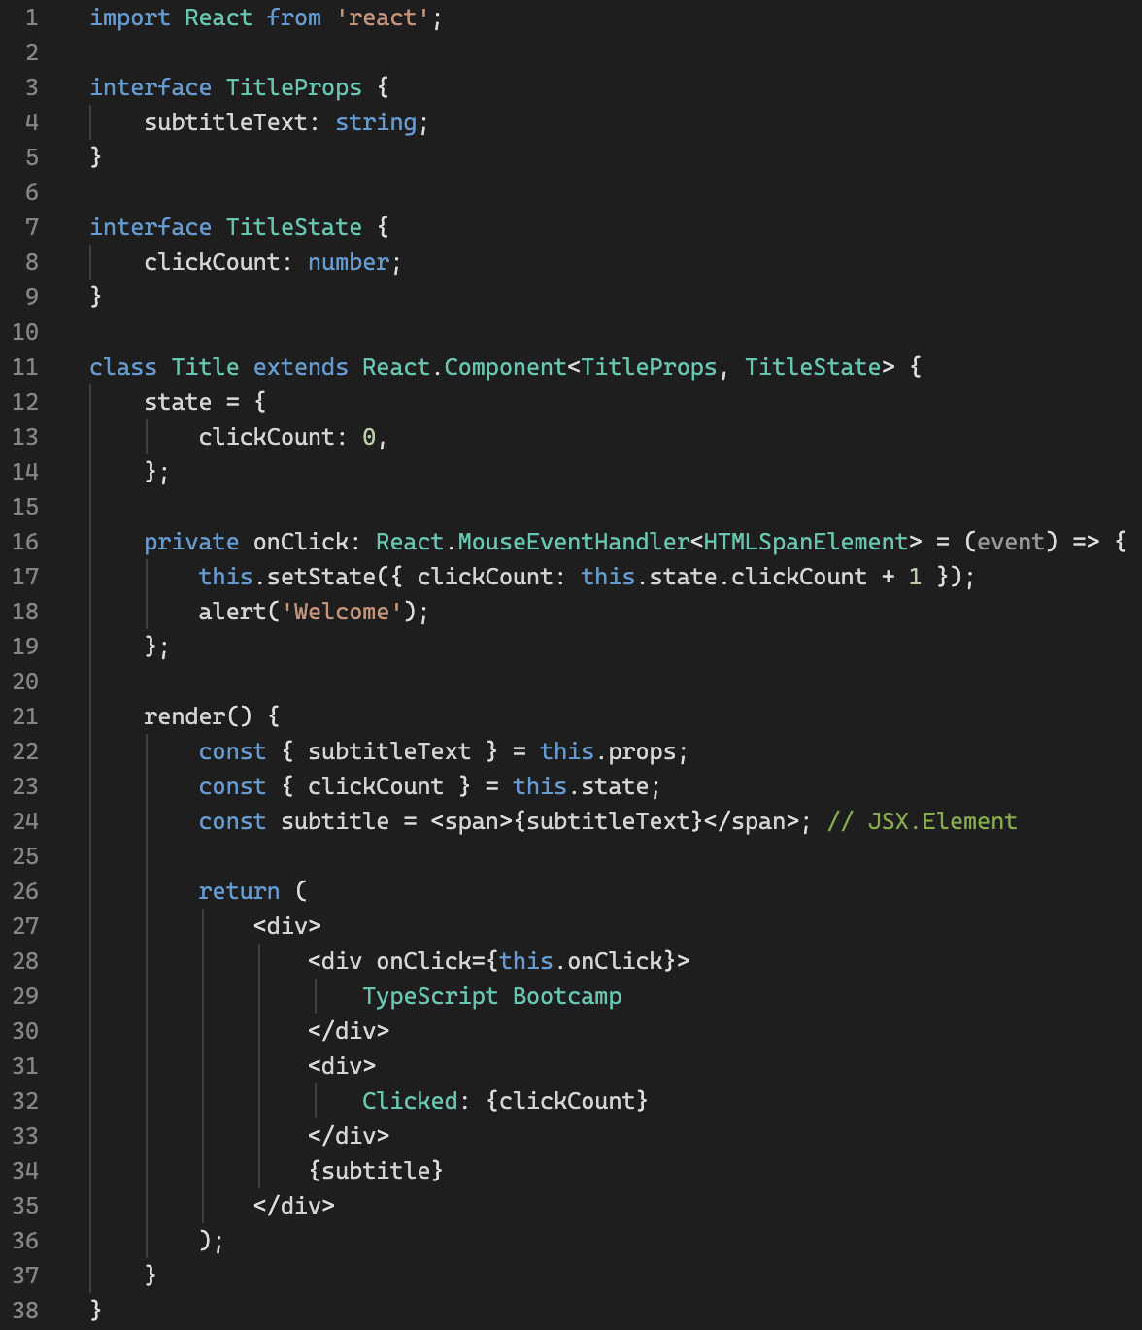
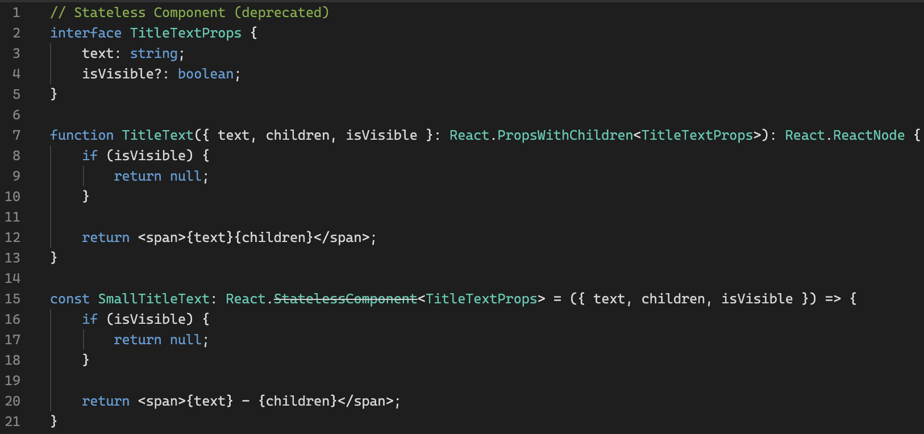
TypeScript + React
Playground link
Codesandbox link
CRA with TS
Bootcamp [TypeScript]

Slide 29
Thank you!
Bootcamp [TypeScript]

